Slide 1

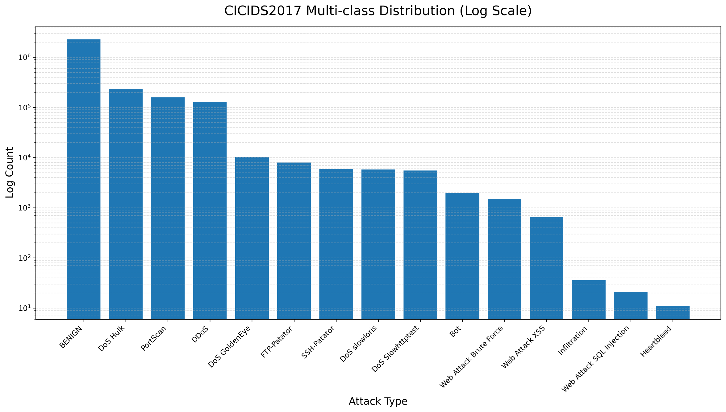
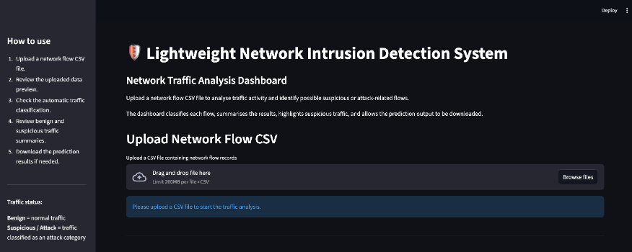
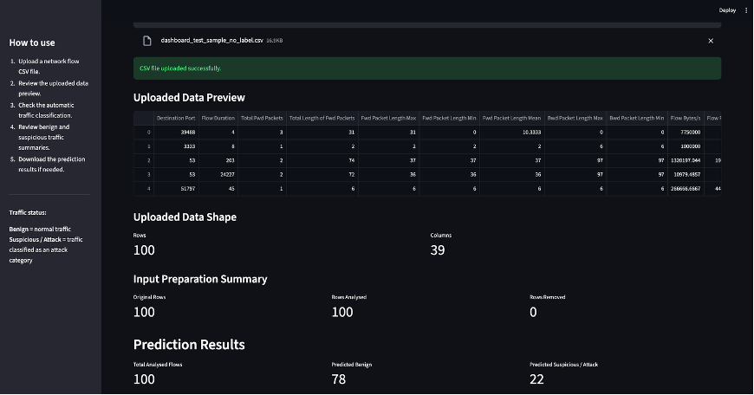
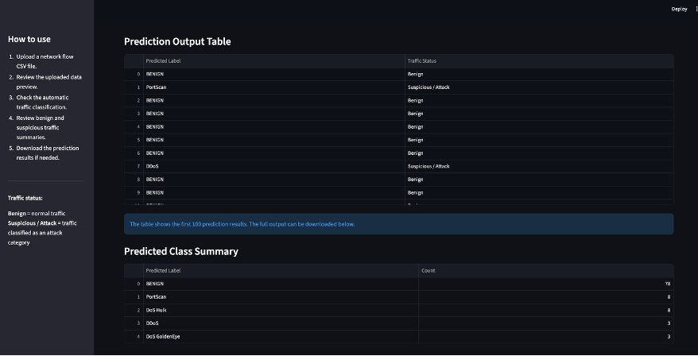
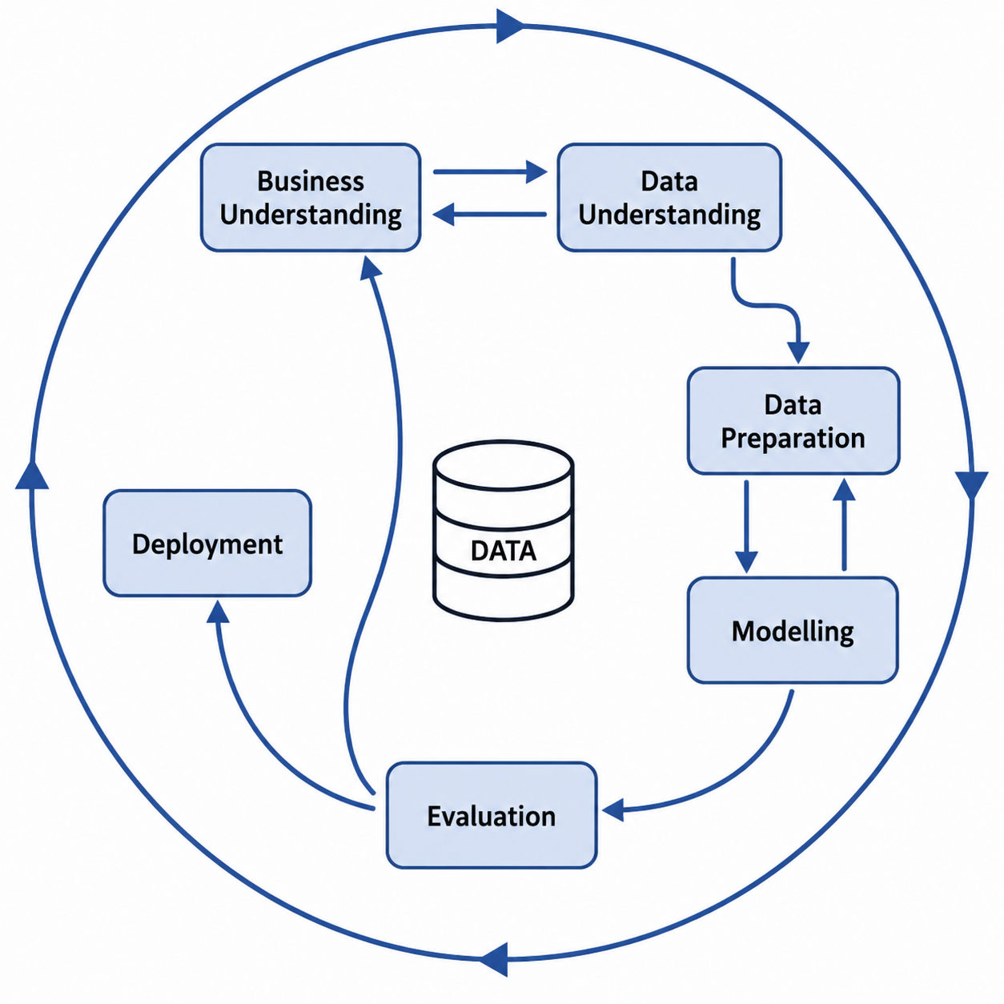
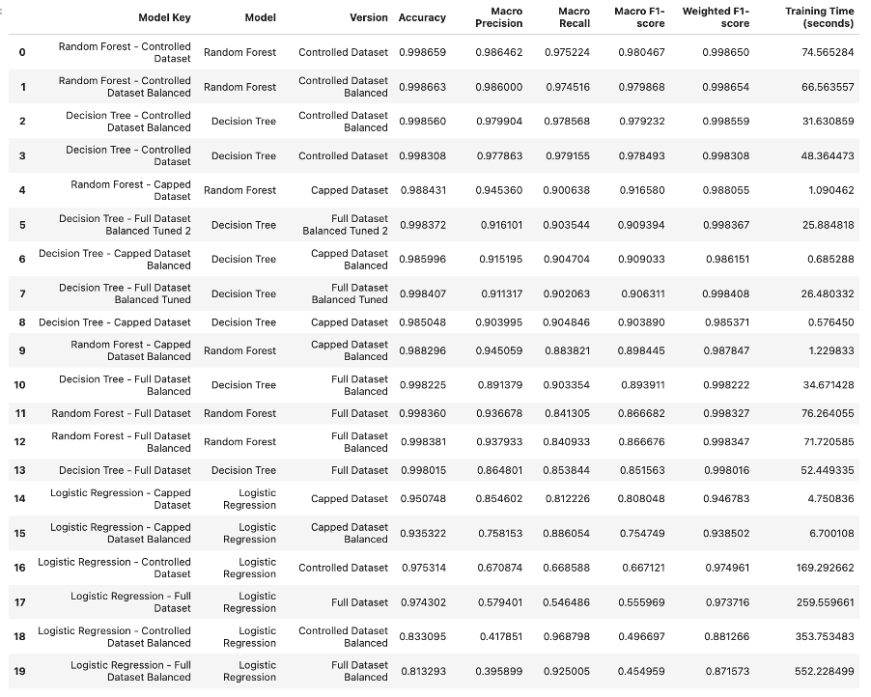
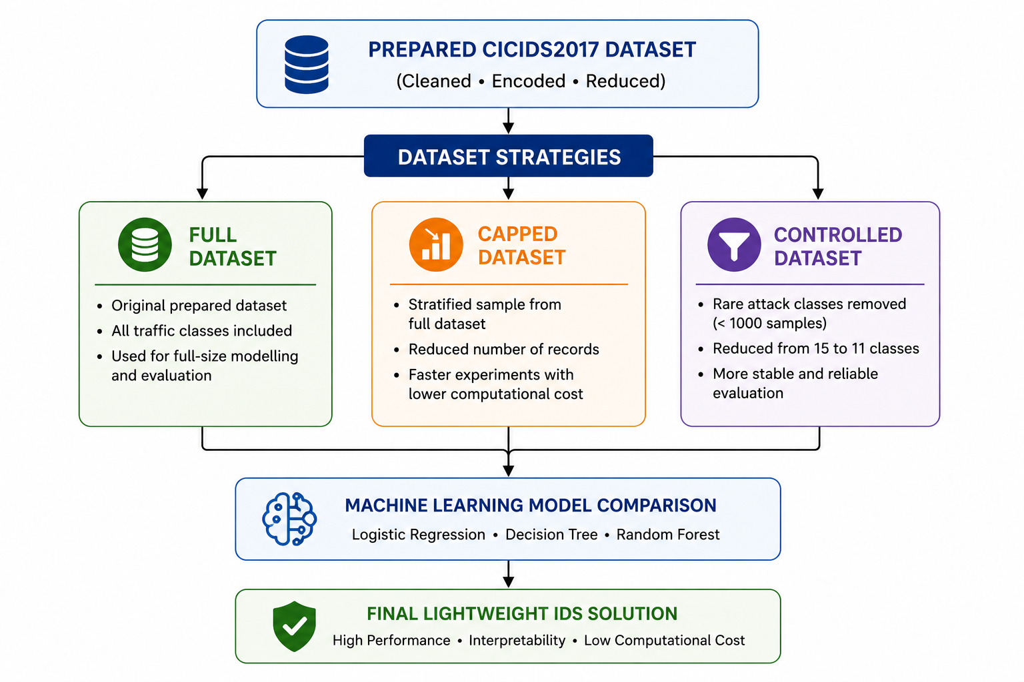
LIGHTWEIGHT NETWORK INTRUSION DETECTION SYSTEM (IDS) USING MACHINE LEARNING FOR CYBERATTACK CLASSIFICATION
Sander Soares & Thiago Gonçalves, CCT College Dublin, May 2026
ABSTRACT
DATA UNDERSTANDING
MODELLING
DEPLOYMENT
This project focused on developing a lightweight Network Intrusion Detection System (IDS) using machine learning techniques to classify benign and malicious network traffic. It followed the CRISP-DM framework and used the CIC-IDS2017 dataset as the main source of network flow data. Multiple preprocessing techniques were applied to prepare this dataset for three different machine learning models: Random Forest, Decision Tree and Logistic Regression. Then, the models were evaluated using accuracy, precision, recall, macro F1-score, and confusion matrix analysis.
The Decision Tree Full Dataset Balanced Tuned 2 model was selected as the final lightweight IDS solution because it achieved the best balance between strong classification performance, attack coverage, interpretability and runtime efficiency.
The Data Understanding phase focused on analyzing the CICIDS2017 dataset before preprocessing and modelling. The dataset was developed and publicly released by the Canadian Institute for Cybersecurity (CIC) at the University of New Brunswick, Canada, and contains benign and the most up-to-date common attacks, which resembles the true real-world data (PCAPs). It also includes the results of network traffics using CICFlowMeter with labeled flows based on the time stamp, source, and destination IPs, source and destination ports, protocols and attack (Sharafaldin et al., 2018).
The dataset was presented in 8 different CSV files, with different traffic’s period and attacks scenario. The dataset after merging had 2,830,743 rows and 79 columns. A total of 1,358 missing values were removed, and we constate that the dataset was very unbalanced, having 80.3% of benign traffic.
Three machine learning models were tested to classify network traffic: Logistic Regression, Random Forest and Decision Tree.
The models were tested using three dataset strategies:
Full Dataset: Kept all 15 traffic classes.
Capped Dataset: Limited large classes to 10,000 records.
Controlled Dataset: Removed classes with fewer than 1,000 records.
Baseline and balanced versions were tested using class_weight=“balanced” to improve minority-class detection.
Decision Tree and Random Forest were trained on the raw datasets, while Logistic Regression used scaled data because it is sensitive to feature magnitude (Nugroho et al., 2018).
After the first results, two tuned Decision Tree versions were also tested. The final tuned version used:
criterion = “log_loss”
class_weight = “balanced”
min_samples_split = 3
random_state = 42
A Streamlit dashboard prototype was created to demonstrate how the final model could be reused outside the notebook (Streamlit, 2024).
The final Decision Tree model was saved using Joblib together with the selected 39 features, label encoder, and trained model file (McQuaid, 2026d).
The dashboard allows the user to upload a CSV file with network flow records, check if the required features are present, run traffic predictions, view benign and suspicious traffic summaries, download the prediction results and view feature importance.
This is still a prototype, not a full production IDS. It does not capture live network packets directly yet.
RESEARCH QUESTIONS
The following four questions represent the main focus of this research study:
Q.1. Which Machine Learning model perform best for multiclass intrusion detection?
Q.2. How does class imbalance affect attack classification performance?
Q.3 Can a lightweight and interpretable model achieve strong IDS performance?
Q.4 What limitations remain in the selected model?
EVALUATION
Models were evaluated using accuracy, precision, recall, macro F1-score, weighted F1-score, confusion matrix and training time (Müller and Guido, 2017).
Accuracy alone was not enough because the dataset was highly imbalanced. Macro F1-score was important because it gives equal weight to each class, including rare attacks.
Logistic Regression was the weakest model. It struggled with minority attack classes and had higher training time.
Random Forest achieved strong results, but it was heavier and less suitable for the lightweight objective.
Decision Tree gave the best balance between classification performance, runtime efficiency, interpretability and attack coverage.
The final selected model was Decision Tree – Full Dataset Balanced Tuned 2.
This model kept all traffic classes and performed strongly on the main classes, while still detecting some rare attacks such as Heartbleed, Infiltration and SQL Injection.
Initial Streamlit IDS dashboard upload screen
CONCEPTUAL FRAMEWORK
This project used the Cross-Industry Standard Process for Data Mining (CRISP-DM) model as a method for creating an efficient and well-structured Lightweight Intrusion Detection System (LIDS). Using the CRISP-DM model allowed the project to follow a systematic approach throughout all six phases of the Data Mining process: Business Understanding, Data Understanding, Data Preparation, Modelling, Evaluation and Deployment. The CRISP-DM model also assisted in maintaining a logical sequence during dataset preprocessing, machine learning experimentation, model evaluation and deployment planning stages (Schröer, et al., 2020)
DATA PREPARATION
The Data Preparation Phase focused on transforming the CICIDS2017 dataset, the source data upon which the automated intelligent security technology will operate, from the cleaned format into a structured format that is suitable for the purposes of machine learning modelling. During this phase, multiple pre-processing techniques were applied including; defining a target, separating the features from the target, label encoding of the target variables, correlation-based feature selection (CFS), splitting the dataset into train/test datasets, scaling features and preparing the dataset to control for the multiple class types. These stages were valuable to the preparation of a reduced dataset, enhance data quality and create models that are compatible with the requirements of the proposed IDS solution while maintaining the lightweight objective.
Uploaded CSV preview, input preparation summary and prediction overview
Prediction output table and predicted traffic class summary
CONCLUSIONS
The project shows that a lightweight machine learning IDS can support the detection of benign and malicious network traffic using CICIDS2017. Decision Tree – Full Dataset Balanced Tuned 2 was selected as the final model because it offered the best balance between performance, runtime, interpretability and attack coverage. The Streamlit prototype showed how the saved model could be reused for traffic prediction and suspicious traffic summaries.
Future improvements for this project could include integrating live network traffic capture for real-time IDS monitoring, retraining the models using newer cybersecurity datasets to improve attack detection, and expanding the Streamlit dashboard with automated alerts and advanced monitoring features. Future research could also compare lightweight machine learning models with deep learning approaches to analyze performance and computational trade-offs.
BUSINESS UNDERSTANDING
Modern organizations increasingly depend on networks, cloud systems, remote access, and online services to support their operations, which also increases their exposure to cyber threats capable of causing downtime, data exposure, financial loss, and reputational damage (O'Donovan, 2025). While larger organizations often have dedicated cybersecurity teams, advanced monitoring systems, and stronger financial resources, many SMEs and smaller organizations operate with limited IT infrastructure and without specialized cybersecurity personnel, making them more vulnerable to network attacks and delayed threat detection (Zamani, 2022).
REFERENCES
McQuaid, D. (2026d) How To Save Trained Machine Learning Models. Machine Learning for AI lecture notes. CCT College Dublin.
Müller, A.C. and Guido, S. (2017) Introduction to Machine Learning with Python: A Guide for Data Scientists. 1st end. Sebastopol, CA: O’Reilly Media.
Nugroho, W.H., Handovo, S. and Akri, Y.J. (2018) An Influence of Measurement Scale of Predictor Variable on Logistic Regression Modeling and Learning Vector Quantization Modeling for Object Classification. Available at: ResearchGate (Accessed: 11 May 2026).
O'Donovan, B. (2025) Ireland at increased risk of cyber attacks - report. Available at: RTÉ News (Accessed: 7 March 2026).
Schröer, C., Kruse, F. and Gómez, J.M. (2020) A Systematic Literature Review on Applying CRISP-DM Process Model. Available at: ScienceDirect (Accessed: 9 May 2026). Sharafaldin, I., Lashkari, A.H. and Ghorbani, A.A. (2018) Intrusion detection evaluation dataset (CIC-IDS2017). Available at: UNB CIC Dataset.
Streamlit (2024) Streamlit Docs. Available at: Streamlit Documentation.
Zamani, S.Z. (2022) ‘Small and Medium Enterprises (SMEs) facing an evolving technological era: a systematic literature review on the adoption of technologies in SMEs’, European Journal of Innovation Management, 25(6). doi: DOI.

